Slide 1


Introduction to DevOps
DevOps is a collaborative approach that combines software development (Dev) and IT operations (Ops). It aims to shorten the software development life cycle and provide continuous delivery with high software quality.
by Anurag Patki
Batch :- 2023-10427
Enrollment No: EBEON1023754924

Slide 2
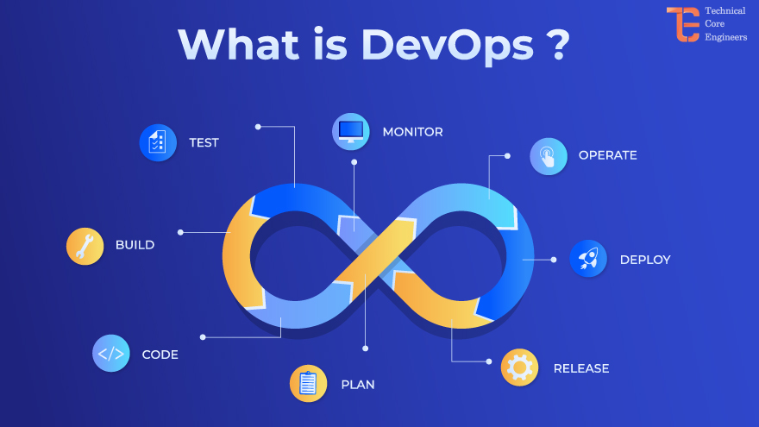
What is DevOps?
DevOps is a set of practices and cultural philosophies emphasizing collaboration and communication between software development and IT operations teams. It aims to automate the process of software delivery and infrastructure changes.

Slide 3
Benefits of implementing DevOps
Improved Deployment Frequency
Increased Efficiency and Productivity
DevOps helps in achieving faster and more frequent deployment of software updates and releases.
Streamlining processes and automating repetitive tasks leads to improved efficiency and productivity across development and operations teams.
Enhanced Reliability and Quality
Improved Collaboration and Communication
By automating testing and integrating continuous monitoring, DevOps contributes to enhanced reliability and overall software quality.
DevOps fosters a collaborative culture, breaking down silos between teams and promoting effective communication, which ultimately boosts overall performance.

Slide 4

Key principles of DevOps
1
Collaboration
DevOps emphasizes collaboration between development and operations teams throughout the product lifecycle.
2
Automation
Automation of processes and tasks ensures efficiency, reliability, and consistency in software delivery.
3
Feedback Loops
Creating feedback loops enables continuous improvement and quick iterations based on real-world usage.

Slide 5
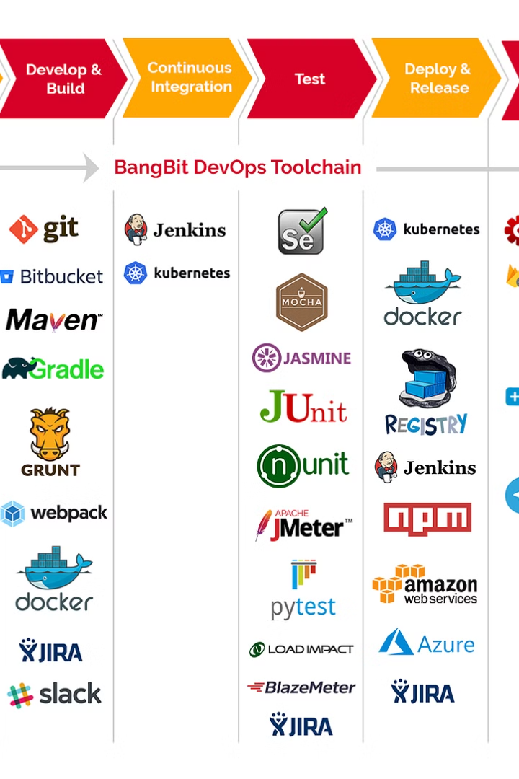
DevOps Tools and Technologies
DevOps employs a wide range of tools and technologies including Docker, Kubernetes, Jenkins, Ansible, and Git. These tools enable automation, streamline collaboration, and facilitate continuous integration & deployment.
Additionally, monitoring tools like Nagios, Prometheus, and ELK stack ensure the stability and reliability of the infrastructure and applications.

Slide 6
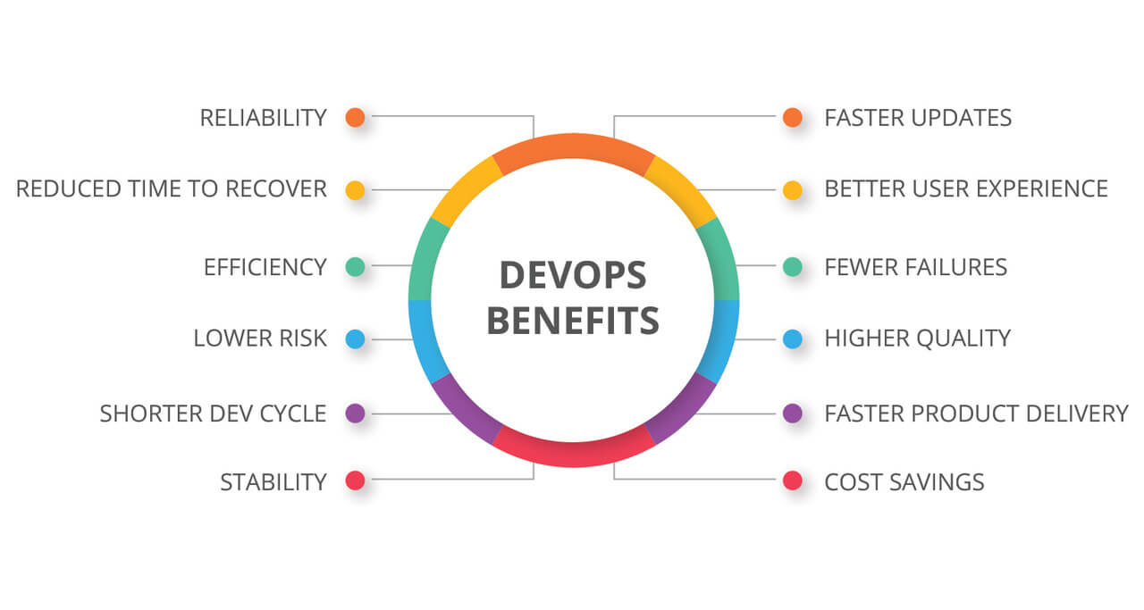
Advantages of DevOps
Improved deployment frequency and time
to market
Enhanced quality of the delivered software
Increased efficiency and productivity of development and operations teams

Slide 7
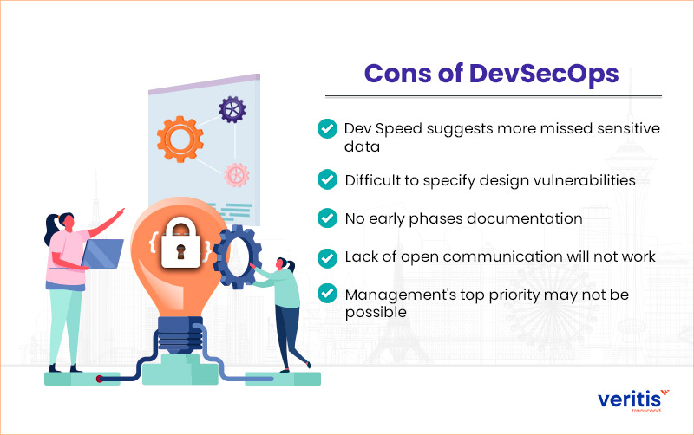
Disadvantages of DevOps
Initial Implementation Challenges: Introducing DevOps may face resistance and require significant changes.
Complexity of Integration: Integrating different tools and processes in DevOps can be complex.
Skills Gap: Organizations may struggle to find and retain skilled DevOps professionals.

Slide 8
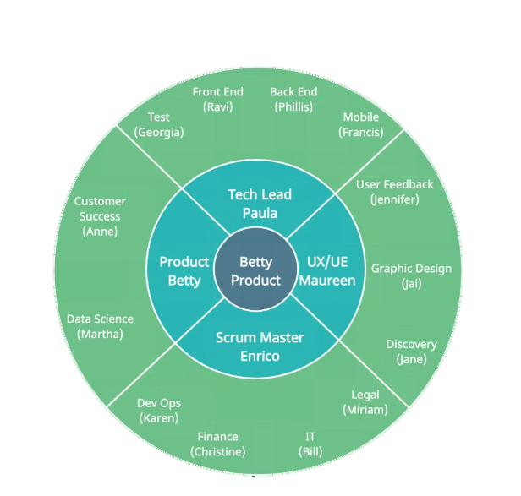
DevOps Culture and Collaboration
DevOps culture emphasizes collaboration, communication, and shared responsibilities among development, operations, and other IT teams.
Teams work together to create a culture of trust, transparency, and continuous improvement in processes and tools.

Slide 9




Continuous Integration and Continuous Deployment (CI/CD)
Streamlined Process
Automated Workflow
Speed and Agility
Continuous Quality
CI/CD streamlines the development and deployment process, enabling rapid and efficient software delivery.
Automated workflows in CI/CD ensure consistent and reliable integration and deployment of code changes.
CI/CD facilitates faster delivery cycles, promoting agility and responsiveness to customer needs.
It emphasizes continuous testing and monitoring to maintain the quality of the software during all stages.

Slide 10

Conclusion and Next Steps
In conclusion, implementing DevOps can greatly enhance software development and deployment processes. The key is to continuously iterate and improve, embracing a culture of collaboration, automation, and integration. Next steps involve monitoring, feedback collection, and further optimization for continuous improvement.

